Slide 1
AirSential
Advanced Smart Device for Air Quality Monitoring, Gas Leak Detection, and Emergency Response
–- Safeguarding Respiratory Health with Intelligent Hazard Prevention
Sagarika Srivastava
e-mail : sagarikasrivastava46@gmail.com
LinkedIn : issrivastava46
GitHub : issrivastava

Slide 2
What is AirSential?
AirSential is an advanced smart device designed to revolutionize air quality monitoring, gas leak detection, and emergency response, safeguarding respiratory health with intelligent hazard prevention.
Built using a combination of cutting-edge sensors—PIR (passive infrared), gas, temperature, and humidity—AirSential leverages sensor fusion technology to enhance data precision and reliability.
By integrating motion detection with PIR sensors, the device ensures higher accuracy in identifying environmental hazards while minimizing false alarms.

Slide 3
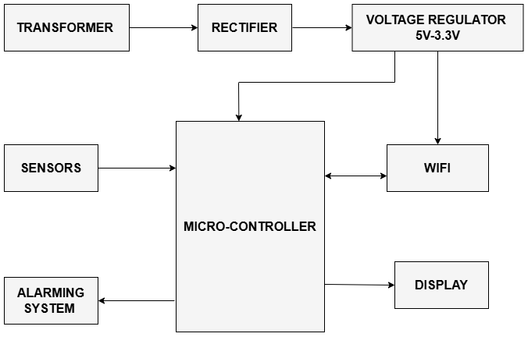

Architecture

Slide 4
Increased Precision
AirSential is powered by microcontrollers and connected via Wi-Fi, enabling real-time monitoring and seamless communication with concerned authorities in case of emergencies.
This comprehensive approach ensures proactive hazard mitigation and promotes safety in residential, industrial, and commercial environments.
Its precision-engineered design and intelligent capabilities make AirSential a robust and indispensable solution for maintaining air quality and preventing environmental threats effectively.

Slide 5
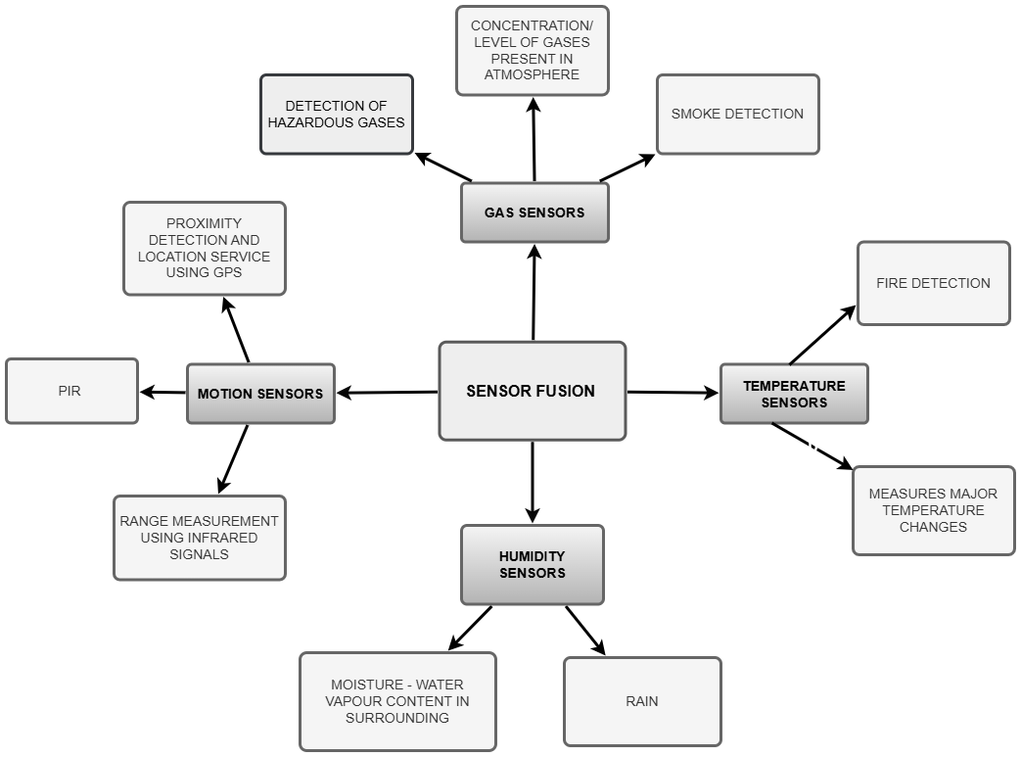

SENSORS

Slide 6
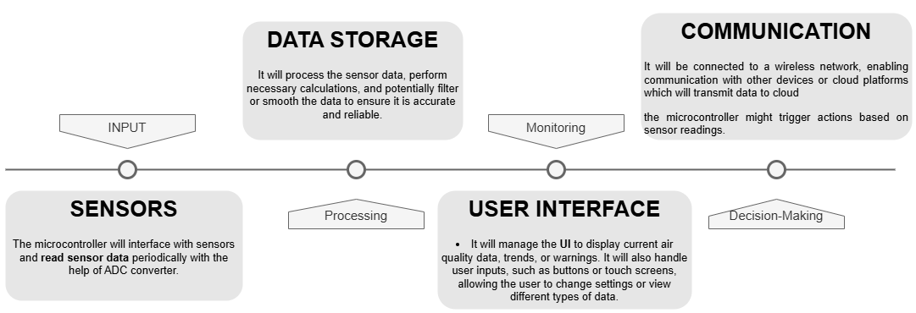

MICRO-CONTROLLER

Slide 7
Implementation
To successfully promote Airsential, a multi-channel approach is essential. The strategy involves leveraging digital marketing through targeted social media campaigns, SEO, and influencer partnerships to build awareness.
Collaborations with smart home companies and healthcare organizations can broaden the product’s reach, while live demonstrations and webinars help engage and educate potential customers on the device's benefits.
Encouraging customer testimonials and offering discounts or referral programs will drive adoption and enhance trust.

Slide 8

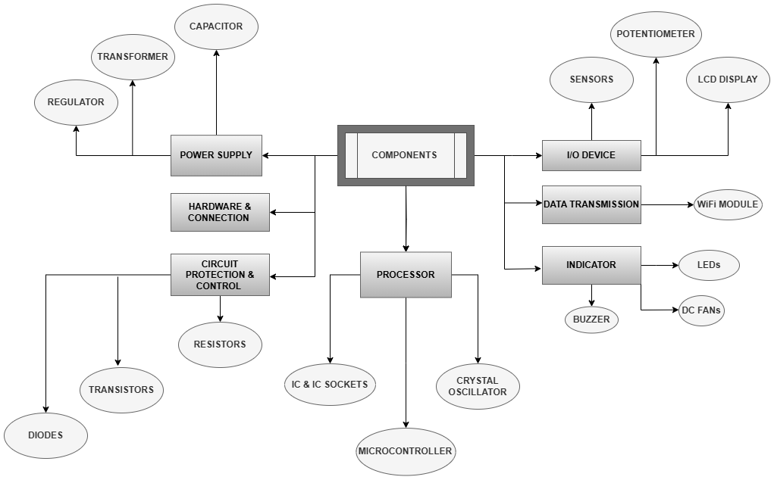
Components

Slide 9
Promotion Strategy
Targeted Digital Marketing - Social Media Campaigns
SEO & Content Marketing - Create awareness and drive traffic to product website.
Partnerships & Collaborations - Work with Healthcare Organizations and NGOa to Expand reach and credibility
Product Demonstrations & Webinars - Organize educational webinars on air quality and gas safety Engage customers and showcase product features.
Customer Testimonials & Reviews - Collect and share user testimonials, Showcase positive reviews and case studies
Discounts & Promotions - Launch limited-time discounts or bundle offers,

Slide 10

Key Partners | Activities | Resources | Value Propositions
Sensor suppliers | R&D, product development | AirSential hardware, cloud services | Monitor air quality and gas leaks
Cloud providers | Marketing & sales | Sensors, IoT devices | Real-time alerts and emergency response
Manufacturers | Customer support | Data infrastructure | Health and safety improvement
Retailers | Regulatory compliance | Development team | Improve air quality in homes, offices, and industries

Slide 11
Revenue Model
Fixed Expenses: Rent & Utilities, Salaries, Depreciation, Insurance, Software Subscriptions, Warehouse Storage
Variable Expenses: Raw Materials, Labour Costs, Shipping & Delivery, Marketing & Advertisment
Semi-Variable Expenses: Maintenance, Hardware
Operational Expenses (OPEX): Training and Development, Office Supplies, Travel Expenses
Capital Expenses (CAPEX):Technology Investments, Infrastructure Upgrades
Contingencies and Emergency Funds:Unplanned Repairs, Economic Downturns:
Taxes and Compliance Costs: Income Taxes, Licensing Fees

Slide 12
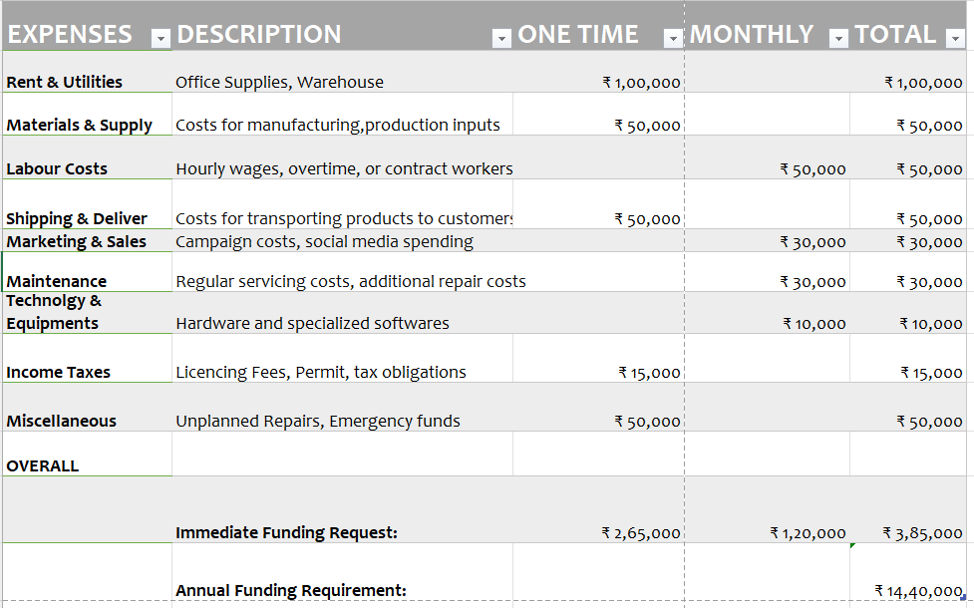

Slide 13
Target Audience
Airsential is designed for individuals and households concerned about indoor air quality, gas leaks, and respiratory health.
The product is ideal for:
Homeowners
Families
Health-conscious Individuals
Smart Home Enthusiasts
Businesses & Offices
Environmental and Safety Advocates
By targeting these groups, Airsential can provide enhanced air safety and quality, becoming an essential part of daily life for those who prioritize health and environmental well-being.

Slide 14
Customer Segment | Needs & Pain Points | Motivation for Buying | How AirSential Can Help
Homeowners | Concerns about indoor air quality (e.g., allergens, pollutants) | Health and safety of family members, asthma or allergy management | Monitors air quality (PM2.5, CO2, VOCs), alerts for harmful gases
Businesses/Offices | Need to ensure employee safety and comply with health regulations | Compliance with health & safety standards, creating a comfortable work environment | Real-time air quality monitoring, data reports for compliance
Schools/Colleges | Ensuring a safe and healthy environment for students and staff | Compliance with educational health standards, improving air quality | Monitors air quality for classroom and common areas
Healthcare Facilities | Maintaining a high-quality environment for patients (e.g., ICU, labs) | Protecting vulnerable individuals (e.g., asthma patients, elderly) | Monitors air quality, detecting harmful gases for better patient care
Industrial Facilities | Need to monitor workplace hazards like gas leaks or poor air quality | Compliance with workplace safety regulations, preventing accidents | Gas leak detection, air quality monitoring in hazardous areas
Smart Cities | Environmental data collection, improving public health and safety | Monitoring and improving city-wide air quality | Integrates into smart city infrastructure, public health monitoring
Environmental Agencies | Tracking pollution levels for regulatory compliance | Data for environmental impact reports, public awareness | Real-time and historical air quality data, extensive monitoring

Slide 15


Thank You !

